Slide 1

Let's build a WEB browser!
Ben Khalfallah Héla

Slide 2
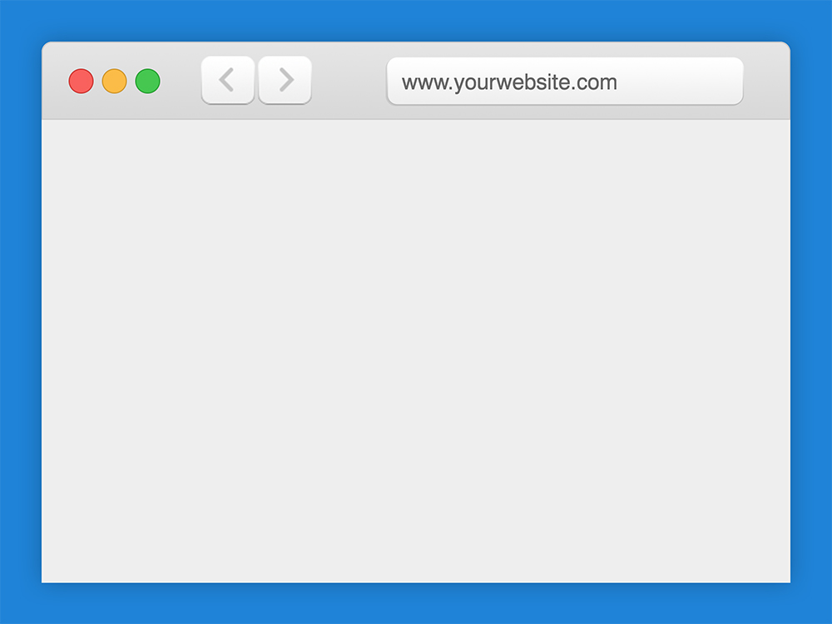

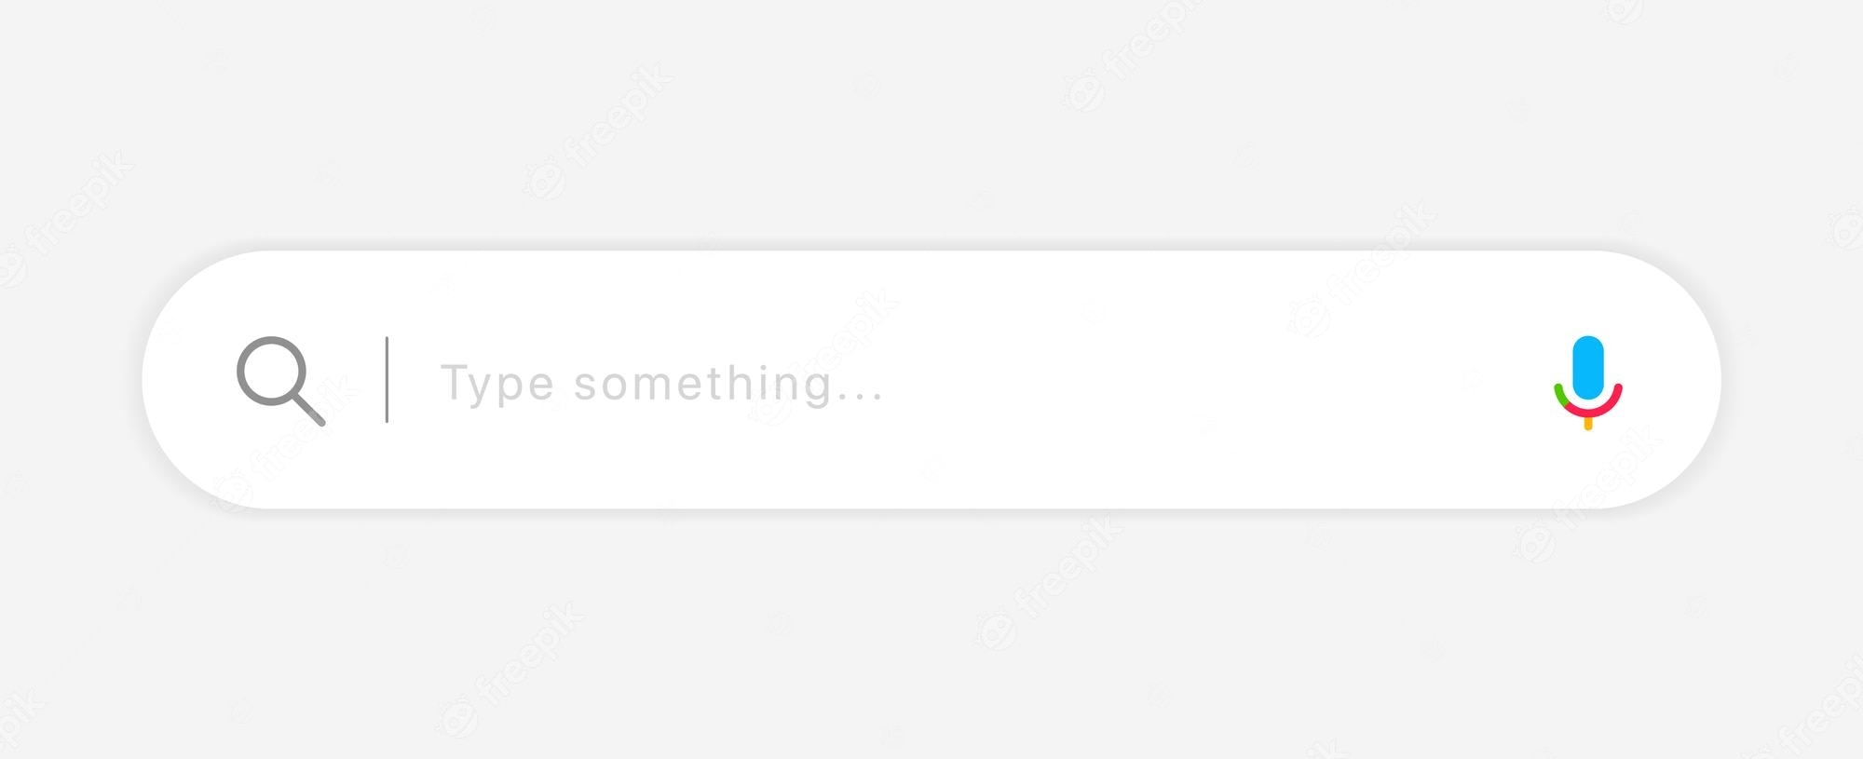
Browser to build
Piper

Slide 3

before starting
Networks, CPUs and Disks all hate you. On the client, you pay for what you send in ways you can't easily see.
- Alex Russell, Software Engineer on Chrome team at Google.

Slide 4

before starting
“Cubes aren’t squares, distance isn’t velocity. Software engineering isn’t programming.”
“Software engineering and programming are related but different problems. If programming is about producing code, software engineering is about maintaining that code for the duration of its usefulness. It is about the practices, policies, and decisions that support robust and reliable code. It is about building for growth and for the ability to manage change, sustainably.”
“Today, software engineers need to know not only how to program effectively but also how to develop proper engineering practices to make their codebase sustainable and healthy.​”
https://abseil.io/resources/swe-book/html/toc.html

Slide 5

steps to follow
Browser's high level structure
Navigation and Content Fetching
Content parsing
Rendering
Compositing
Metrics and Tools

Slide 6
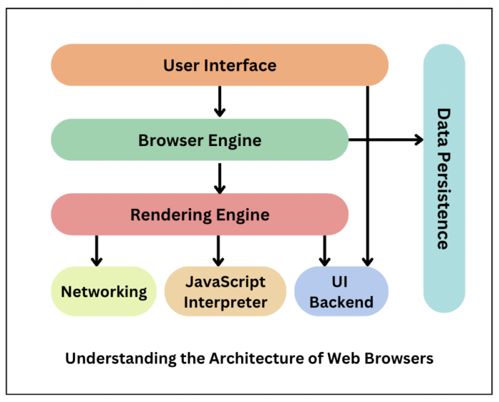
Browser's high level structure
The user interface: this includes the address bar, back/forward button, bookmarking menu, etc. Every part of the browser display except the window where you see the requested page.
The browser engine: marshals actions between the UI and the rendering engine.
The rendering engine: responsible for displaying requested content. For example if the requested content is HTML, the rendering engine parses HTML and CSS, and displays the parsed content on the screen.
Networking: for network calls such as HTTP requests, using different implementations for different platform behind a platform-independent interface.
UI backend: used for drawing basic widgets like combo boxes and windows. This backend exposes a generic interface that is not platform specific. Underneath it uses operating system user interface methods.
JavaScript interpreter. Used to parse and execute JavaScript code.
Data storage. This is a persistence layer. The browser may need to save all sorts of data locally, such as cookies. Browsers also support storage mechanisms such as localStorage, IndexedDB, WebSQL and FileSystem.
Browser Software

Slide 7
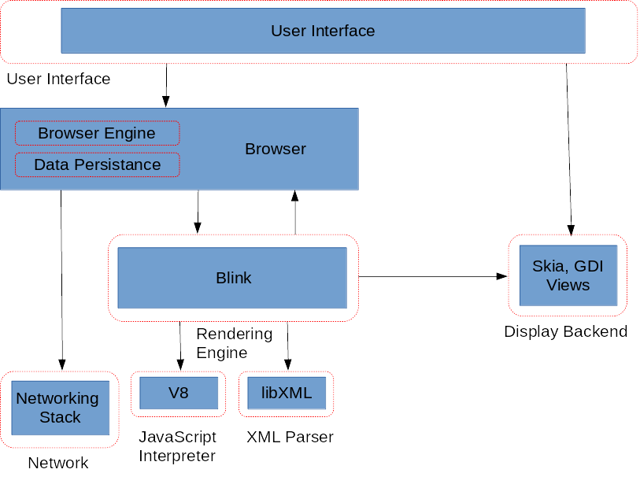
Chrome architecture
https://github.com/chromium/chromium

Slide 8
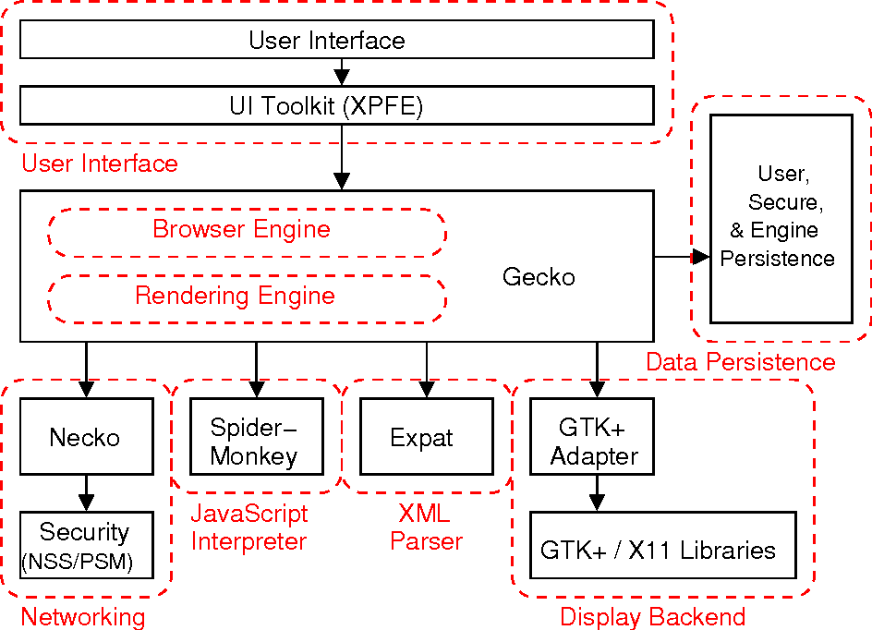
Firefox architecture
https://github.com/mozilla/gecko-dev

Slide 9
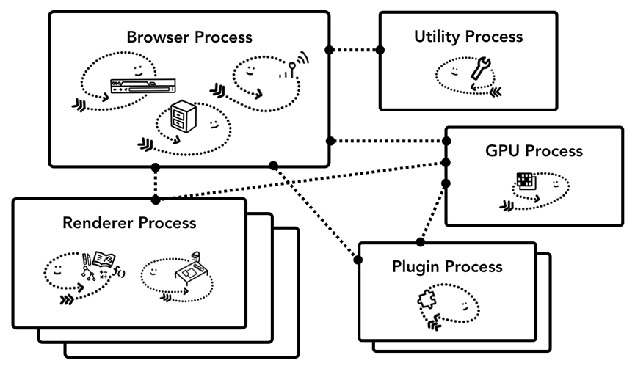
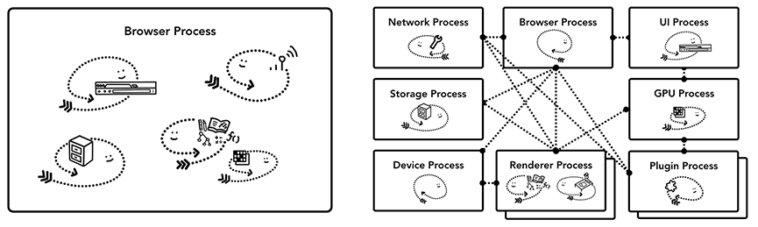
Browser multi-process Architecture
Web browser built could be one process with many different threads or many different processes with a few threads communicating over IPC.

Slide 10
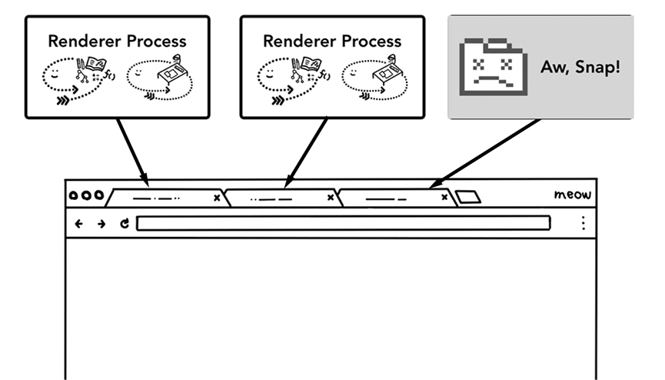
Browser tabs (multi-process)
Each tab has its own renderer process.
If one tab becomes unresponsive, then you can close the unresponsive tab and move on while keeping other tabs alive.
If all tabs are running on one process, when one tab becomes unresponsive, all the tabs are unresponsive. That’s sad.

Slide 11
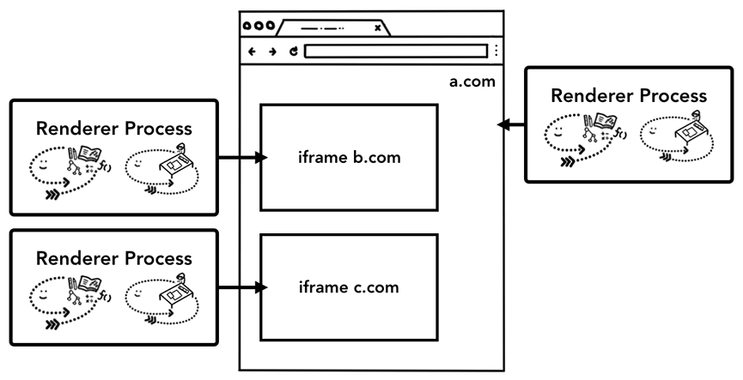
Per-frame renderer processes
https://developer.chrome.com/blog/site-isolation/
Site Isolation

Slide 12

Navigation and content fetching
Handling input
Start navigation
Read response
Find a renderer process
Commit navigation

Slide 13
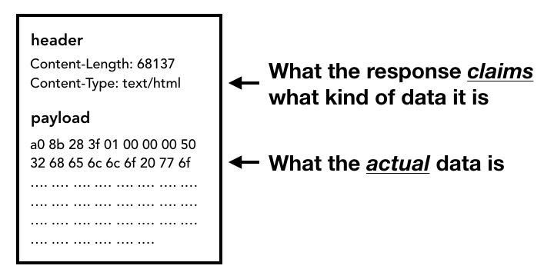
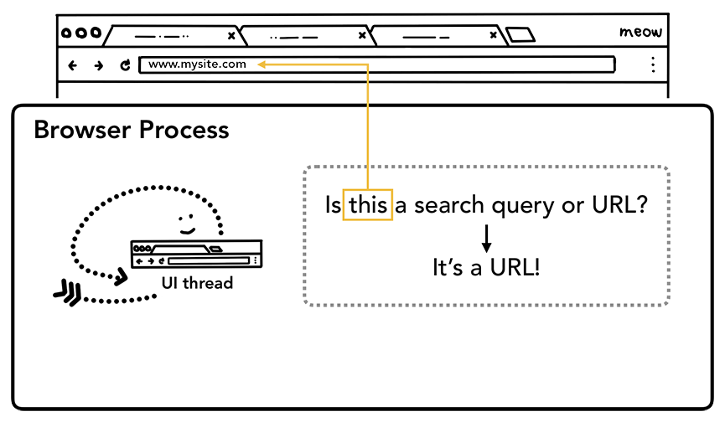
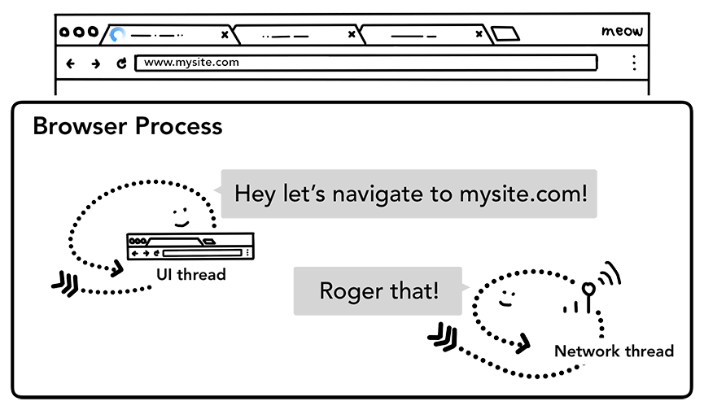
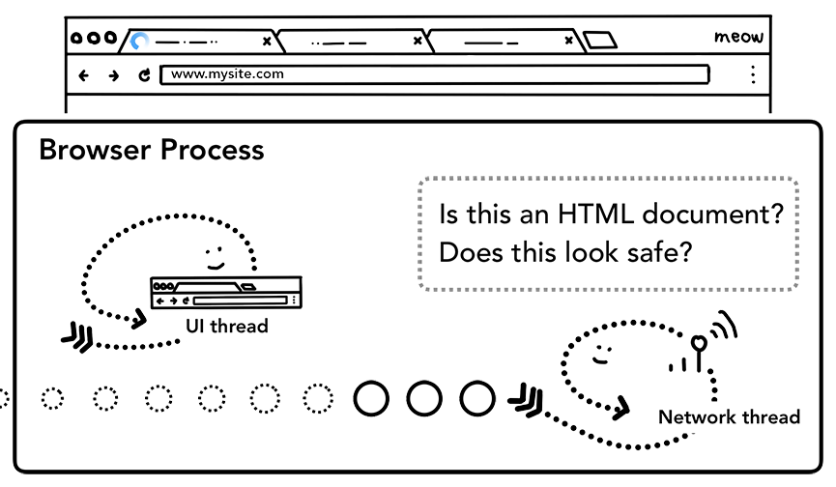
navigation
Handling input
Start navigation
Read response
Initial Flow

Slide 14
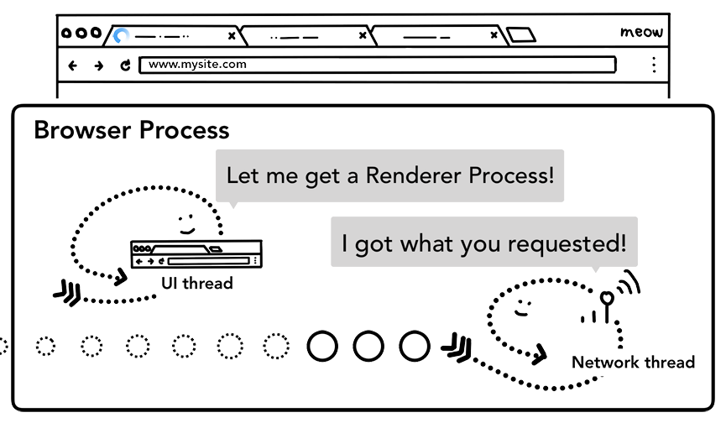
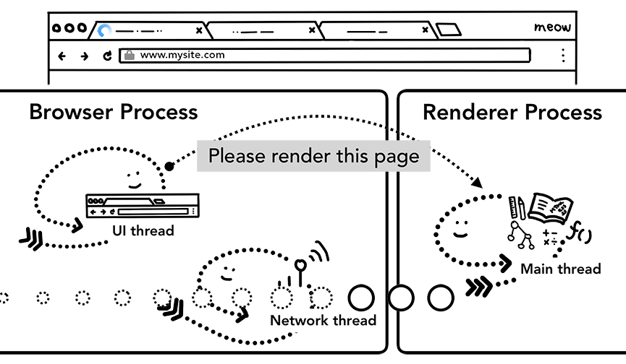
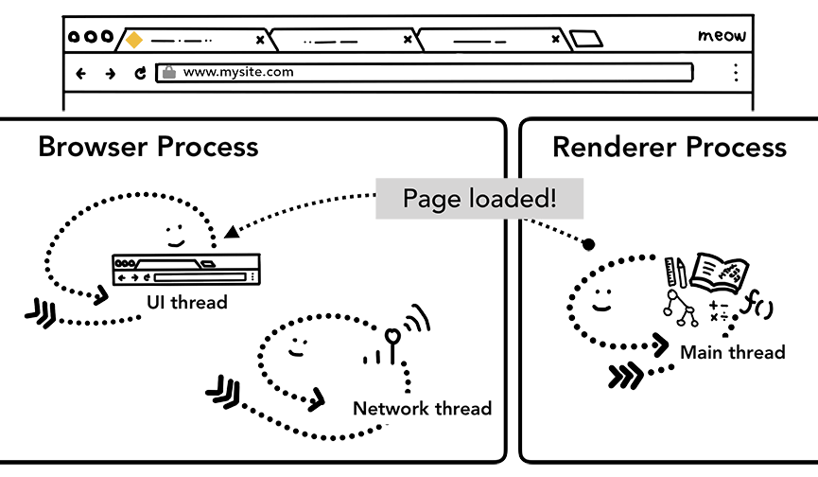
navigation
Find a renderer process
Commit navigation
Initial load complete
Initial Flow

Slide 15
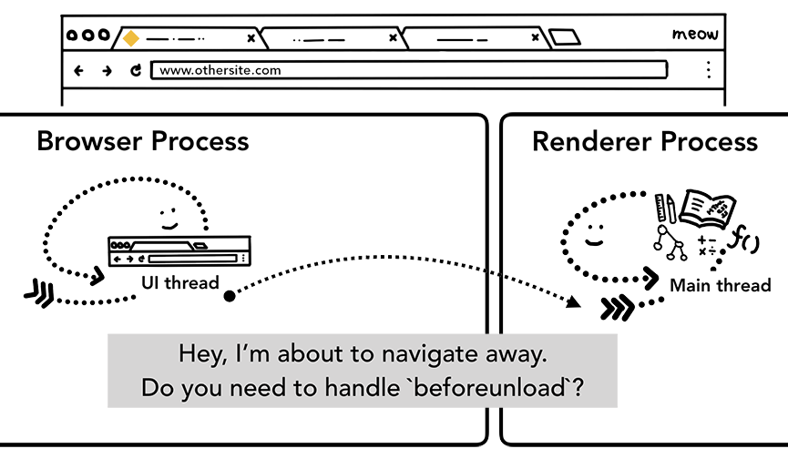
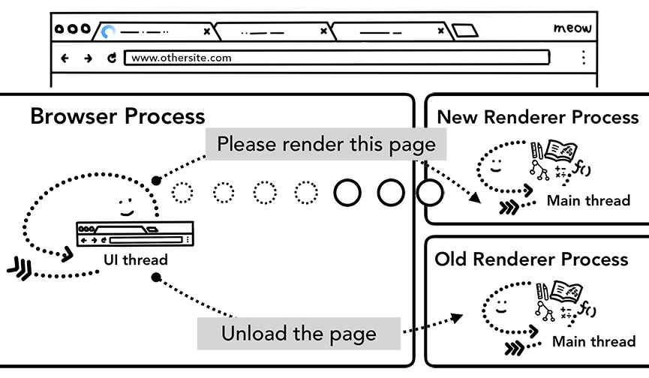
Navigating to a different site
Changing page

Slide 16
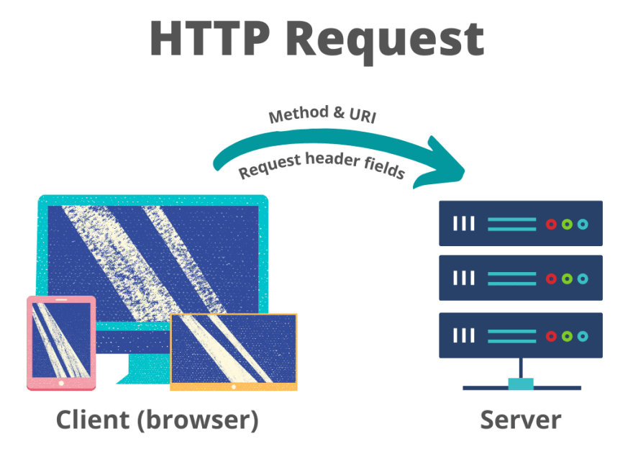
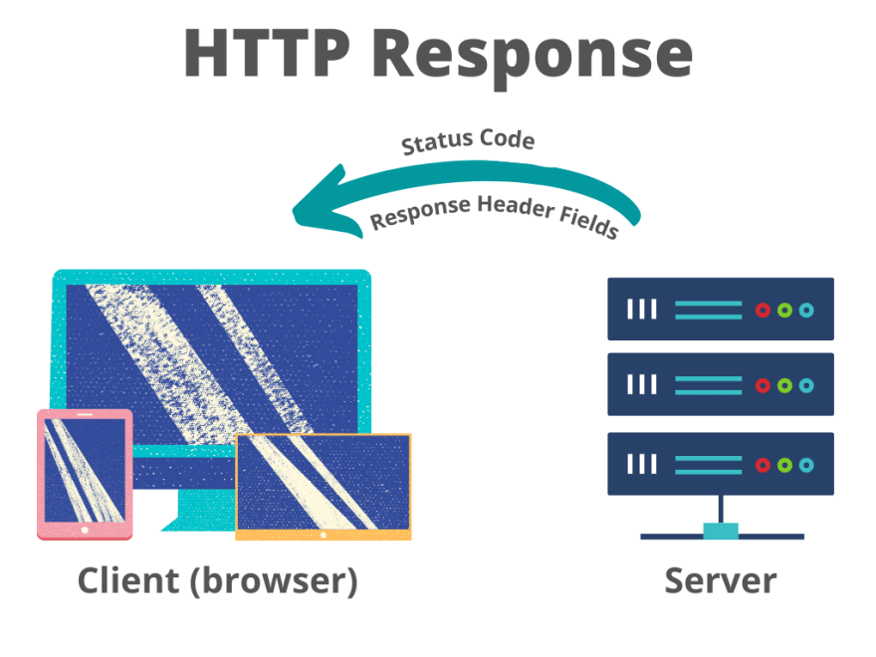
Navigation & Fetching content
<!doctype HTML> <html>
<head> <meta charset="UTF-8"> <meta name="viewport" content="width=device-width, initial-scale=1.0"> <meta http-equiv="X-UA-Compatible" content="ie=edge"> <title>This is my page</title> <link rel="stylesheet" src="styles.css"/> <script src="mainScripts.js"></script> </head>
<body> <h1 class="heading">This is my page</h1> <p>A paragraph with a <a href="https://example.com/about">link</a></p> <div> <img src="myImage.jpg" alt="image description"/> </div> <script src="sideEffectsScripts.js"></script> </body>
</html>
Time to First Byte (TTFB) is the time between when the user made the request (by typing the website's name in the address bar) and the receipt of the first packet of HTML.

Slide 17
Content Parsing
HTML parsing
CSS parsing
JavaScript parsing and execution
Accessibility Tree
Render Tree

Slide 18
content parsing
The HTML and CSS parsing will be done by the browser engine (Gecko, Blink, WebKit, …)

Slide 19
content parsing
The JavaScript parsing and execution will be done by JavaScript Engine (V8, Spider Monkey)

Slide 20
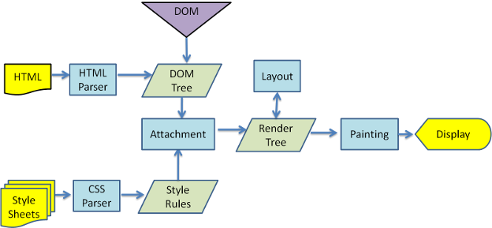
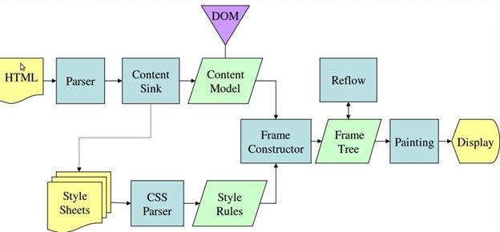
Overview of the parsing model
WebKit main flow
Mozilla's Gecko rendering engine main flow
Main Flow

Slide 21
parsing
General Concepts

Slide 22
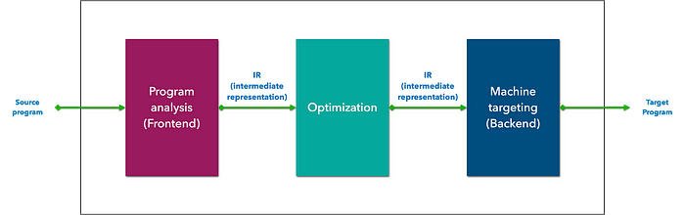
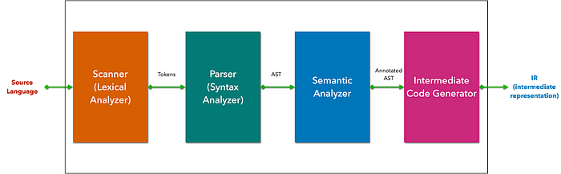
Parsing

Slide 23
Language grammar
Dictionary definition (tokens)
Grammar definition
Errors definition
Grammar

Slide 24
Scanner (lexer)
int value1 = 5; int value2 = 2; // calculate the sum of two integers int function sum(x: int, y: int) { return x + y; }
The scanner will analyze the source program’s character stream and turn it into a token stream.
It also removes white space and comments.
Errors that might occur during scanning are called lexical errors:
The scanner will detect all unknown words and throw an unknown identifier error.
If a keyword is misused, the scanner will throw a reserved keywords error .
integer value1 = 5; // unknown token integer int function = 5; // function is a reserved keyword INT value1 = 5; // unknown token INT, H# is case sensitive println() // unknown token println
Lex (software) – Wikipedia
Flex (lexical analyser generator) – Wikipedia
Programming languages under the hood | Better Programming

Slide 25
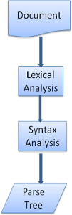
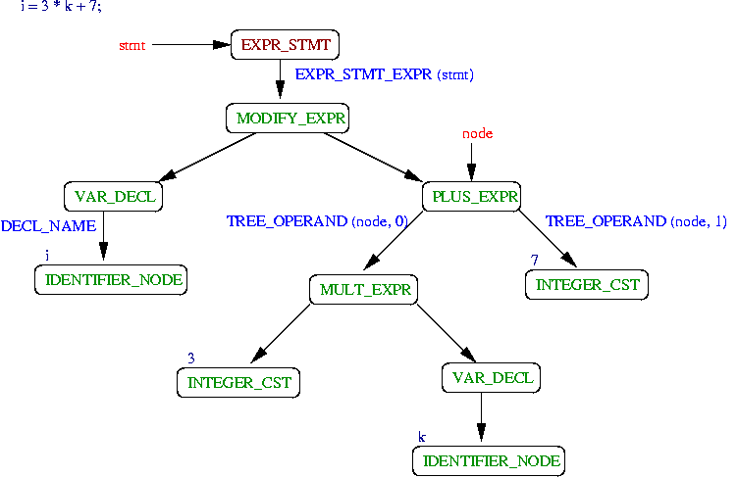
parser
The scanner combines symbols into tokens, and the parser combines tokens to form sentences.
The parser has the main responsibility for recognizing the syntax, determining whether the program being compiled is a valid sentence in the syntactic model of the programming language.
It converts tokens into a tree that represents the actual structure of the code: AST.
The parsing process is iterative.
The parser will usually ask the lexer for a new token and try to match the token with one of the syntax rules.
If a rule is matched, a node corresponding to the token will be added to the parse tree and the parser will ask for another token.
If no rule matches, the parser will store the token internally, and keep asking for tokens until a rule matching all the internally stored tokens is found. If no rule is found then the parser will raise an exception. This means the document was not valid and contained syntax errors.
AST representation in GCC (u-strasbg.fr)
Yacc – Wikipedia
Bison - Parser C-Language Interface (esiee.fr)
Programming languages under the hood | Better Programming

Slide 26
Html parsing
From Bytes to DOM

Slide 27
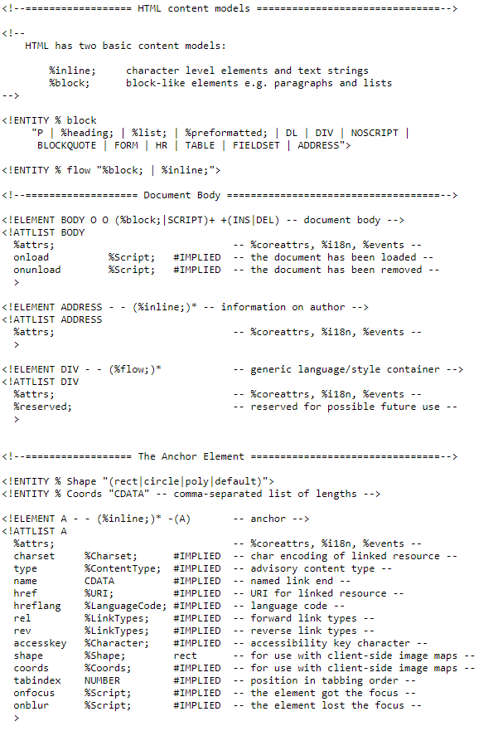
HTML grammar definition
The vocabulary and syntax of HTML are defined in specifications created by the W3C organization.
HTML definition is in a DTD format.
This format is used to define languages of the SGML family.
The format contains definitions for all allowed elements, their attributes and hierarchy.
https://www.w3.org/TR/html4/strict.dtd

Slide 28
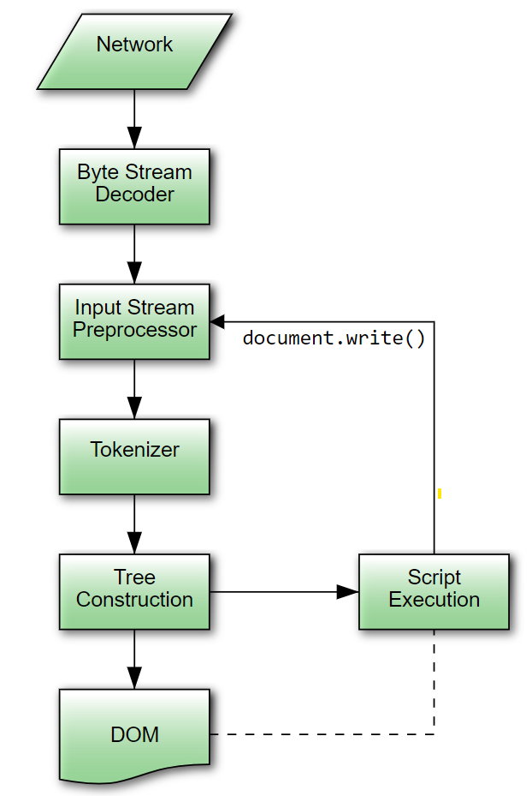
html parser flow
“The input to the HTML parsing process consists of a stream of code points, which is passed through a tokenization stage followed by a tree construction stage. The output is a Document object.”
HTML Standard (whatwg.org)

Slide 29
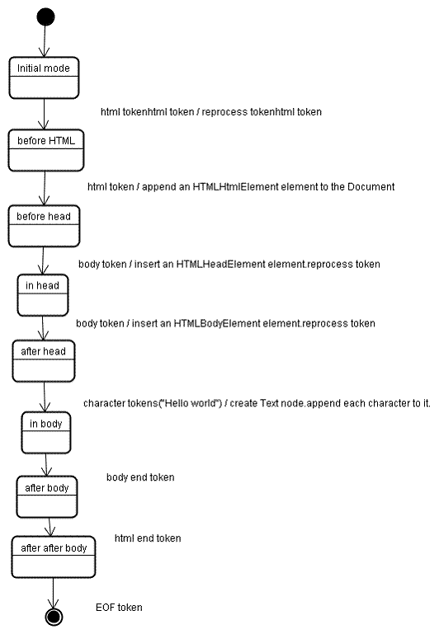
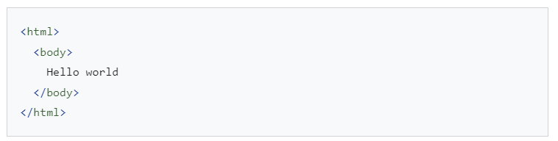
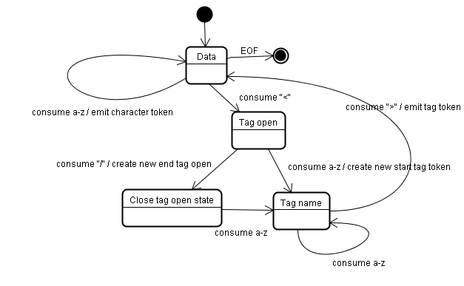
tokenization algorithm

Slide 30
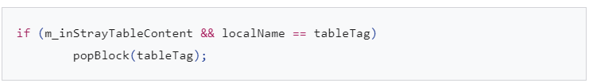
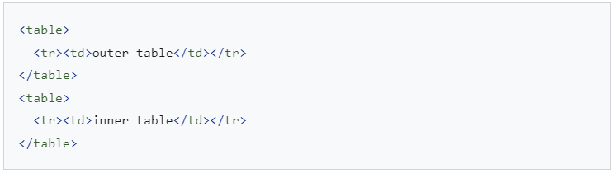
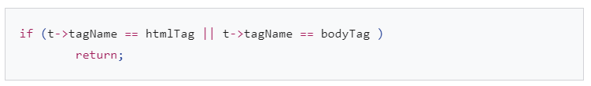
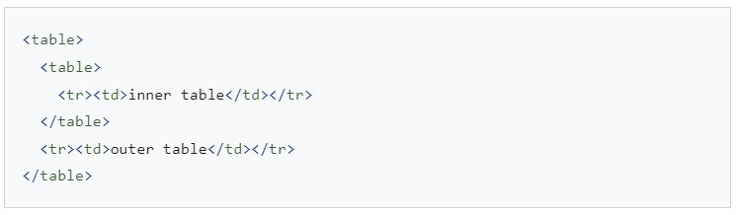
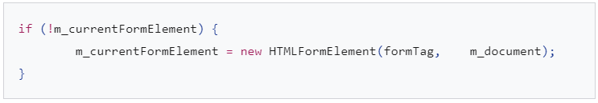
Browsers' error tolerance
A stray table :
You never get an "Invalid Syntax" error on an HTML page. Browsers fix any invalid content and go on.
Misplaced html or body end tags :
Nested form elements: in case the user puts a form inside another form, the second form is ignored :
WebKit

Slide 31
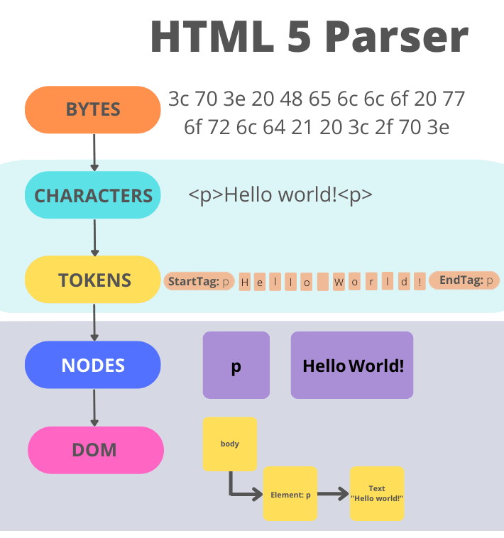
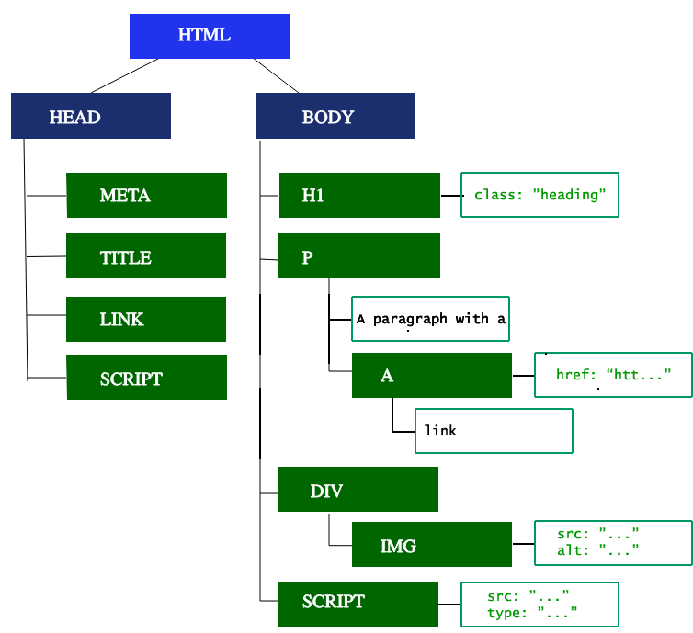
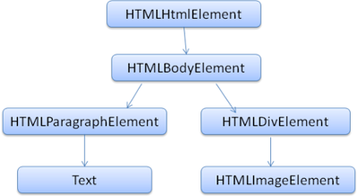
html parser flow
From Bytes To DOM

Slide 32
CSS parsing
From Bytes to CSSOM

Slide 33
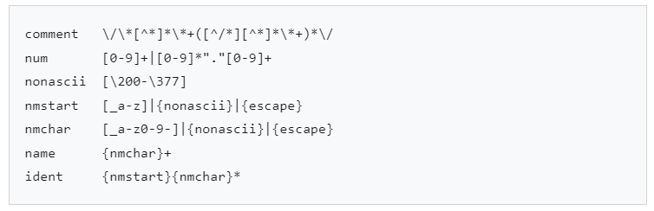
CSS parsing
Unlike HTML, CSS is a context free grammar.
The lexical grammar (vocabulary) is defined by regular expressions for each token:
CSS Snapshot 2023 (w3.org)

Slide 34
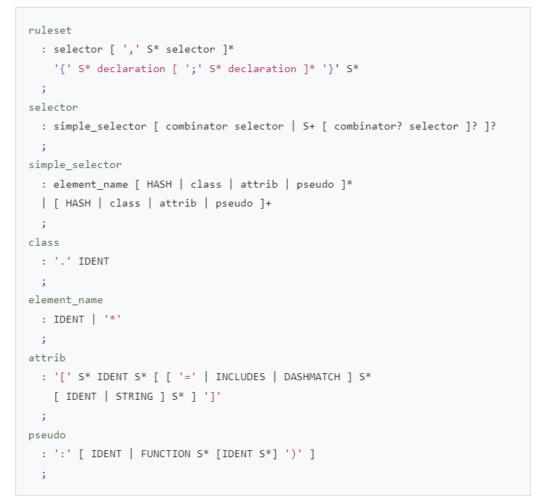
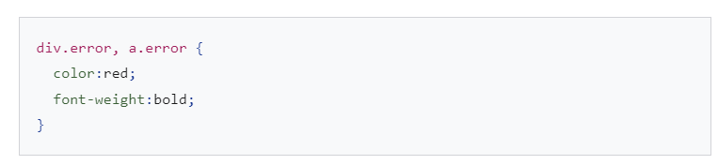
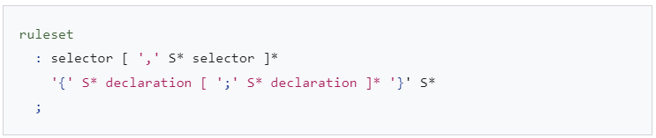
CSS parsing
The syntax grammar is described in BNF.
CSS Snapshot 2023 (w3.org)

Slide 35
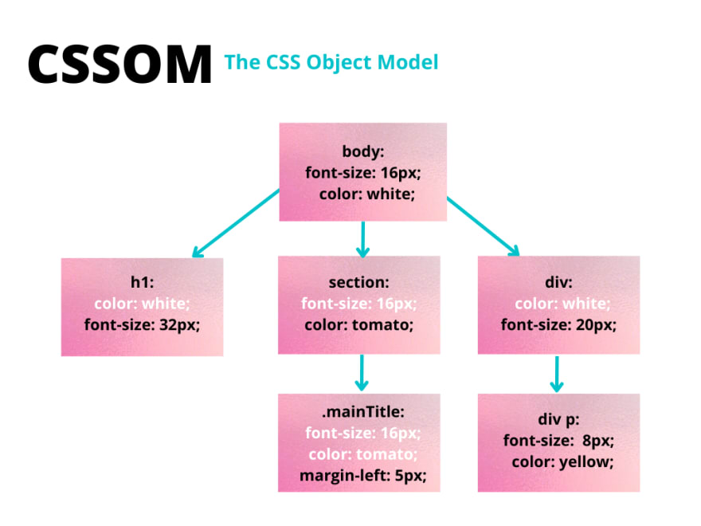
CSS parsing
body { font-size: 16px; color: white; } h1 { font-size: 32px; } section { color: tomato; } section .mainTitle { margin-left: 5px } div { font-size: 20px; } div p { font-size: 8px; color: yellow; }

Slide 36
JavaScript parsing and execution
From Bytes to Execution

Slide 37
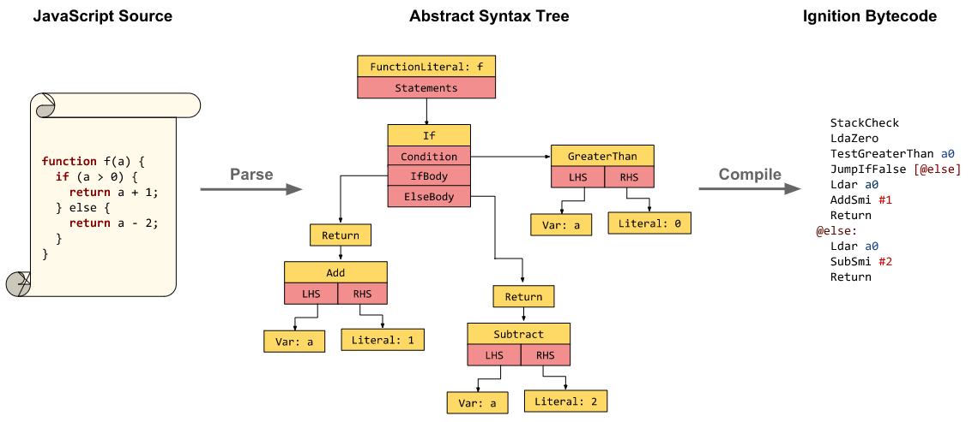
JavaScript parsing flow
Background compilation · V8

Slide 38
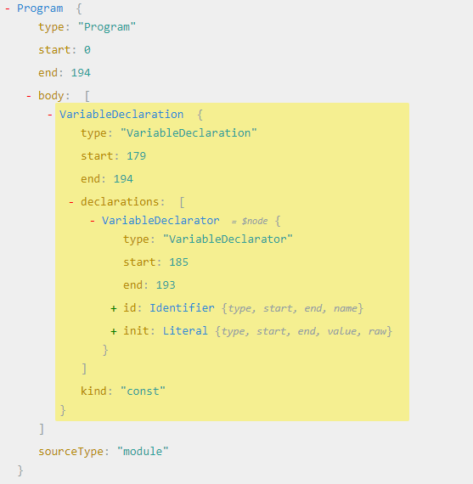
JavaScript parsing flow
const age = 25;
When JavaScript code enters the JavaScript engine it gets parsed as a first step.
This means the code is read, and while this is happening, the code is transformed into a data structure called the Abstract Syntax Tree (AST).
The code will be split into pieces that are relevant to the language (like function or const keywords) and then all these pieces will build the Abstract Syntax Tree.
After the AST has been built, it gets translated into machine code and executed right away, since modern JavaScript uses Just-In-Time compilation.
AST explorer

Slide 39
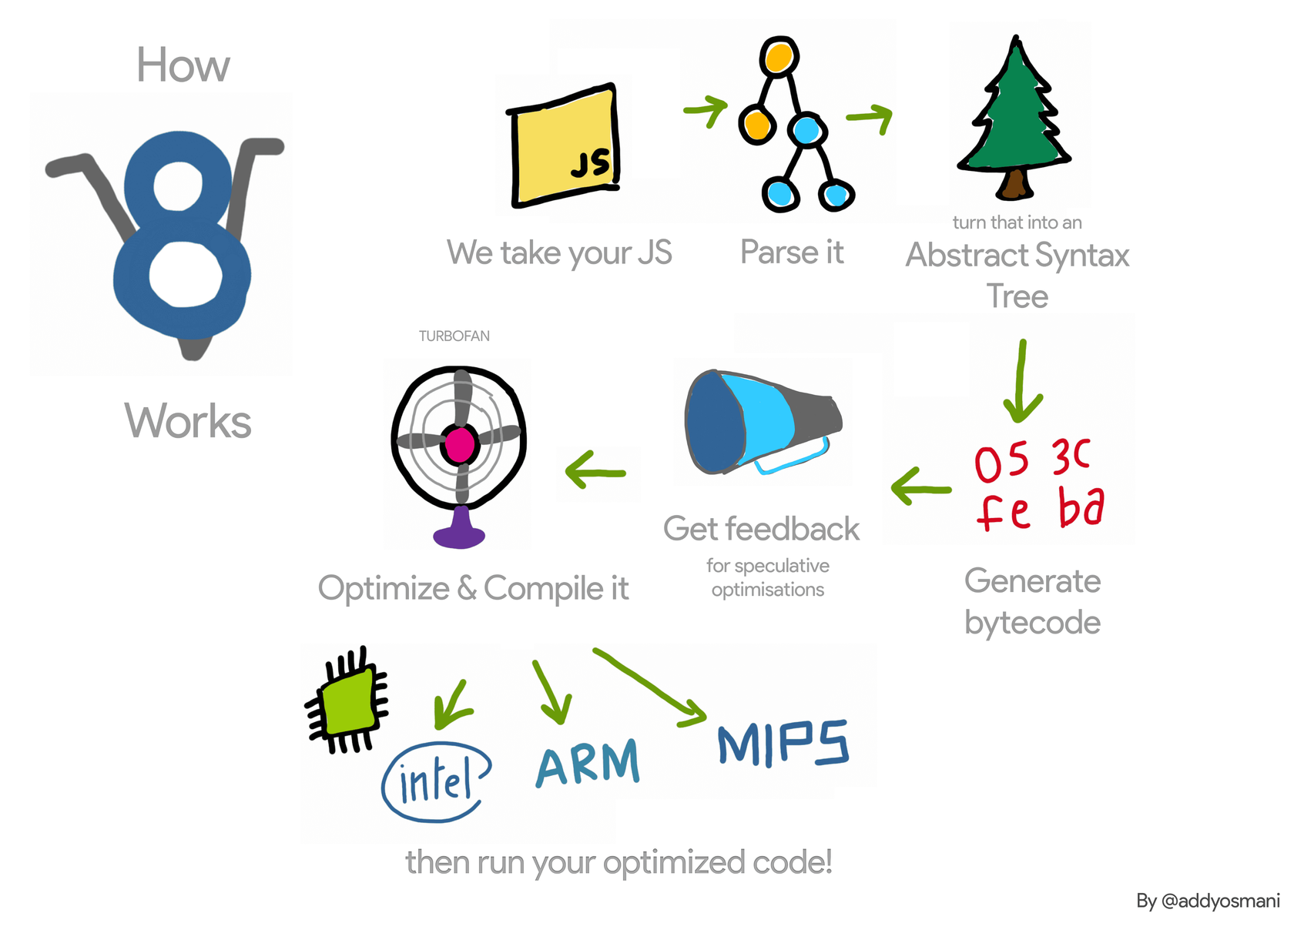
V8 engine operation
V8 JavaScript engine

Slide 40
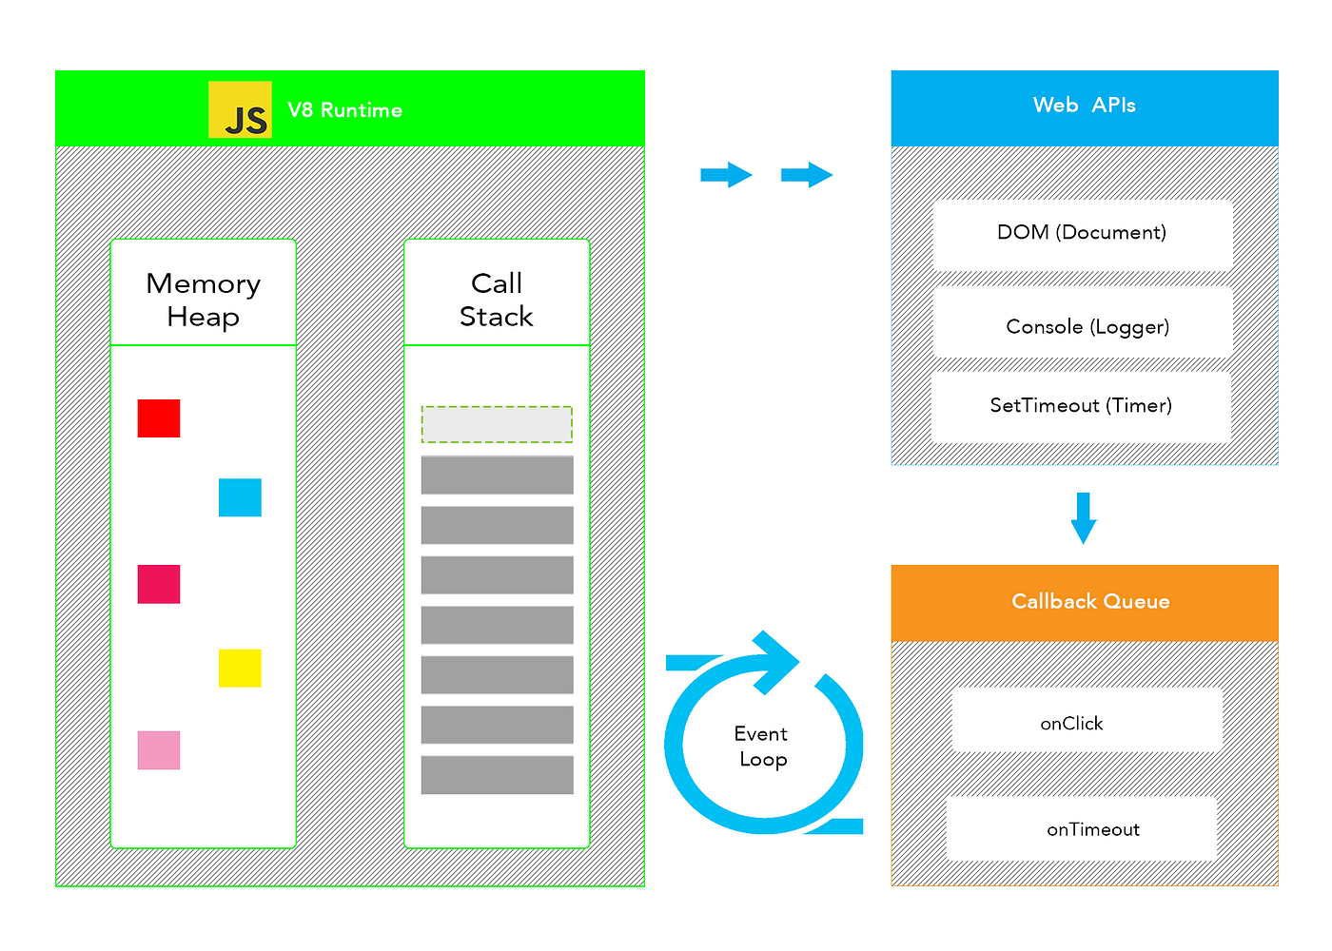
JavaScript execution flow
JavaScript | MDN (mozilla.org)
“JavaScript (JS) is a lightweight, interpreted, or just-in-time compiled programming language with first-class functions. While it is most well-known as the scripting language for Web pages, many non-browser environments also use it, such as Node.js, Apache CouchDB and Adobe Acrobat. JavaScript is a prototype-based, multi-paradigm, single-threaded, dynamic language, supporting object-oriented, imperative, and declarative (e.g. functional programming) styles.”

Slide 41
Accessibility tree
From DOM to AOM

Slide 42
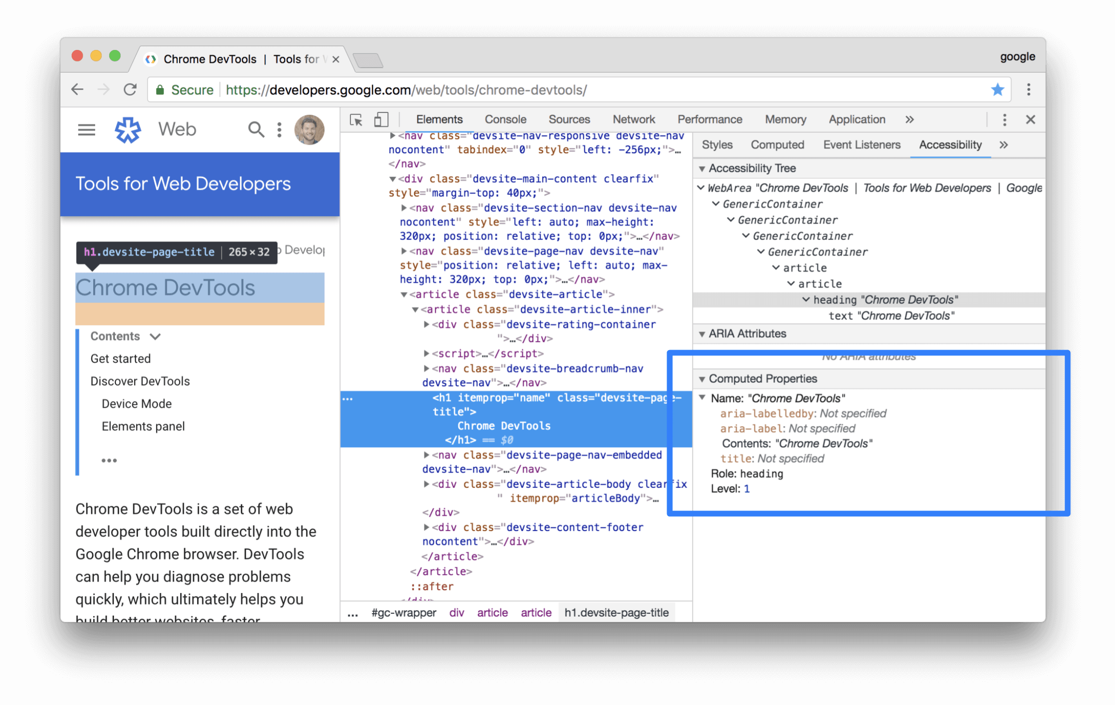
Accessibility Tree (AOM)
Accessibility features reference - Chrome Developers
The accessibility object model (AOM) is like a semantic version of the DOM. The browser updates the accessibility tree when the DOM is updated. Until the AOM is built, the content is not accessible to screen readers.

Slide 43
Render tree
Combining parts

Slide 44
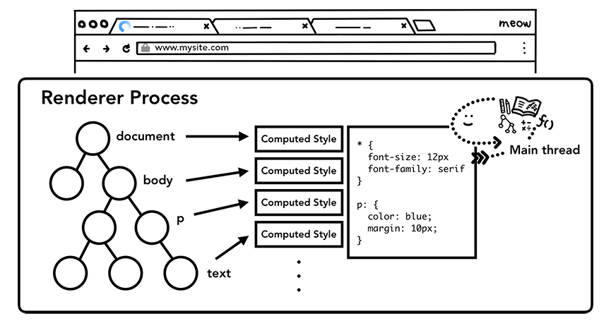

combining the DOM with the CSSOM
Now that the information has been parsed the browser can begin to display it.
To achieve this the browser will now use the render tree to produce a visual representation of the document.
The browser will start doing its magic at the root of the DOM tree and traverse every visible node. Some of the nodes, like script or meta tags are not visible, so they are ignored.
There are also nodes that will be hidden with the use of CSS (the display: "none" property for example) and they will also be ignored.
We are only interested in the visible nodes because only they matter for the input on the screen.
For each visible node that's found in the DOM, the corresponding rules will be found in the CSSOM and they will be applied.
Render Tree contains all visible nodes, with content and styles.

Slide 45




The order of processing scripts and style sheets
The model of the web is synchronous.
Authors expect scripts to be parsed and executed immediately when the parser reaches a <script> tag.
The parsing of the document halts until the script has been executed.
If the script is external then the resource must first be fetched from the network - this is also done synchronously, and parsing halts until the resource is fetched.
This was the model for many years and is also specified in HTML4 and 5 specifications.
Authors can add the "defer" attribute to a script, in which case it will not halt document parsing and will execute after the document is parsed.
HTML5 adds an option to mark the script as asynchronous so it will be parsed and executed by a different thread.
Firefox blocks all scripts when there is a style sheet that is still being loaded and parsed. WebKit blocks scripts only when they try to access certain style properties that may be affected by unloaded style sheets.

Slide 46


Preload Scanner (Speculative parsing)
While the browser builds the DOM tree, this process occupies the main thread.
As this happens, the preload scanner will parse through the content available and request high priority resources like CSS, JavaScript, and web fonts.
Thanks to the preload scanner, we don't have to wait until the parser finds a reference to an external resource to request it.
It will retrieve resources in the background so that by the time the main HTML parser reaches requested assets, they may already be in flight, or have been downloaded.
The speculative parser only parses references to external resources like external scripts, style sheets and images: it doesn't modify the DOM tree - that is left to the main parser.
Waiting to obtain CSS doesn't block HTML parsing or downloading, but it does block JavaScript, because JavaScript is often used to query CSS properties' impact on elements.

Slide 47

Rendering
Layout (reflow)
Painting (repainting)

Slide 48


Layout (reflow)
The render tree holds information on which nodes are displayed along with their computed styles, but not the dimensions or location of each node.
What needs to be done next is calculate the exact position of those nodes within the viewport of the device (inside the browser window) and their size.
This is the stage called layout (in Chrome, Opera, Safari and Internet Explorer) or reflow (in Firefox) but they mean the same thing. The browser starts this process at the root of the render tree and traverses it.
The reflow step doesn't happen only once, but every time we change something in the DOM that affects the layout of the page, even partially.
Examples of situations when the positions of the elements is recalculated are:
adding or deleting elements from the DOM.
resizing the browser window.
changing the width, the position of an element or floating it.

Slide 49



Painting (repainting)
After the browser decides which nodes need to be visible and calculates their position in the viewport, it's time to paint them (render the pixels) on the screen.
This phase it is also known as the rasterization phase, where the browser converts each box calculated in the layout phase to actual pixels on the screen.
Just like the layout stage, the painting stage doesn't happen just once but every time we change something in the appearance of the elements on the screen.
Examples of these situations are:
changing the outline of an element.
changing background color.
changing opacity or visibility.
Painting means the browser needs to draw every visual part of an element to the screen, including text, colors, borders, shadows, and replaced elements like buttons and images and it needs to do it super quickly.
To ensure repainting can be done even faster than the initial paint, the drawing to the screen is generally broken down into several layers. If this occurs, then compositing is necessary.

Slide 50
Layering and compositing
Dividing into layers
Raster and composite

Slide 51


Dividing into layers
In order to find out which elements needs to be on which layer, the main thread walks through the layout tree and creates the layer tree.
By default, there's only one layer (and how these layers are implemented is browser specific) but we can find the elements that would trigger a repaint and create a separate layer for each of them.
This way, the repainting should not be applied to the whole page and in addition, this process will use the GPU.
If we want to hint to the browser that certain elements should be on a separate layer, we can use the will-change CSS attribute.
There are actually specific properties and elements that signal the creation of a new layer. Some of these are <video>, <canvas>, and any element which has the CSS properties of opacity, a 3D transform, will-change and a few others. These nodes will be painted onto their own layer, along with their descendants.

Slide 52


Raster and composite off of the main thread
Once the layer tree is created and paint orders are determined, the main thread commits that information to the compositor thread.
The compositor thread then rasterizes each layer.
A layer could be large like the entire length of a page, so the compositor thread divides them into tiles and sends each tile off to raster threads.
Raster threads rasterize each tile and store them in GPU memory.

Slide 53

Main and compositor threads

Slide 54

Critical rendering path

Slide 55

Critical rendering path

Slide 56

Metrics and tools
FCP
FID
LCP
CLS
Core Web Vitals
Tools
Performance Budgets

Slide 57

Metrics

Slide 58

FCP
Ce métrique mesure le temps entre le début du chargement de la page et le moment où une partie du contenu de la page est affichée à l'écran.
https://xblocks.socgen/#/client/awt-react-optimisation-webpack.md

Slide 59

FID
First Input Delay consiste à mesurer le temps de réaction entre le moment où l'internaute va interagir sur une page pour la première fois et la réponse du navigateur.
https://xblocks.socgen/#/client/awt-react-optimisation-webpack.md

Slide 60

LCP
Cette métrique va permettre de calculer précisément le temps que met le premier – et le plus grand – élément à apparaître sur le site. Cela peut être une image, une vidéo ou un bloc de texte, cela va dépendre de ce que contient le site en question.
https://xblocks.socgen/#/client/awt-react-optimisation-webpack.md

Slide 61

CLS
Le Cumulative Layout Shift ou « décalage cumulatif de mise en page » mesure la stabilité visuelle.
https://xblocks.socgen/#/client/awt-react-optimisation-webpack.md

Slide 62

Metrics

Slide 63
tools
Bundle Analyzer
Performance Dev Tool
Network Dev Tool
Memory Dev Tool
Accessibility Dev Tools
https://developer.chrome.com/docs/devtools/

Slide 64


Performance budgets
go/house
Continuous performance monitoring

Slide 65

final notes
Best practices

Slide 66
The expert's word
Networks, CPUs and Disks all hate you. On the client, you pay for what you send in ways you can't easily see.
- Alex Russell, Software Engineer on Chrome team at Google.

Slide 67
Optimize your loading sequence
Fast at
Download, parse, compile & execute.
Bundle Splitting
Split your code into small, reusable pieces.
Tree Shaking
Reduce the bundle size by eliminating dead code (using modular libs, ESM).
Route Based Splitting
Dynamically load components based on the current route.
Import On Visibility
Load non-critical components when they are visible in the viewport.
Import On Interaction
Load non-critical resources when a user interacts with UI requiring it.
List
Optimize list performance with list virtualization, load more, pagination.
https://www.patterns.dev/

Slide 68

Optimize your loading sequence
Progressive Loading

Slide 69

The expert's word
It's impossible to build large applications in JavaScript, but only as much as it is in any other programming dialect. Ideally, you should be creating smaller modules of functionality which together form your larger app.
- Software Engineer at Google working on the Chrome web browser.

Slide 70
performance and quality monitoring tools
go/house
Jenkins
Bundle Analyzer
DevTools (Chrome, React & Redux)

Slide 71
The expert's word
Really care about the tools you use because they are what make you your best.
- Software Engineer at Google working on the Chrome web browser.

Slide 72
recommandations
Read documentation
Use Tools
Ask Questions
Share Knowledge

Slide 73
Available documentation
https://xblocks.socgen/#/client/awt-react-optimisation-webpack.md
https://xblocks.socgen/#/client/awt-react-project-sante.md
https://xblocks.socgen/#/client/awt-v4-react-checklist.md
https://www.a11yproject.com/checklist/
https://webaim.org/standards/wcag/checklist

Slide 74
that's all folks
What a journey !

Slide 75



books

Slide 76

see you soon !
Ben Khalfallah Héla

